Slide 1
職場
趣聞

Slide 2
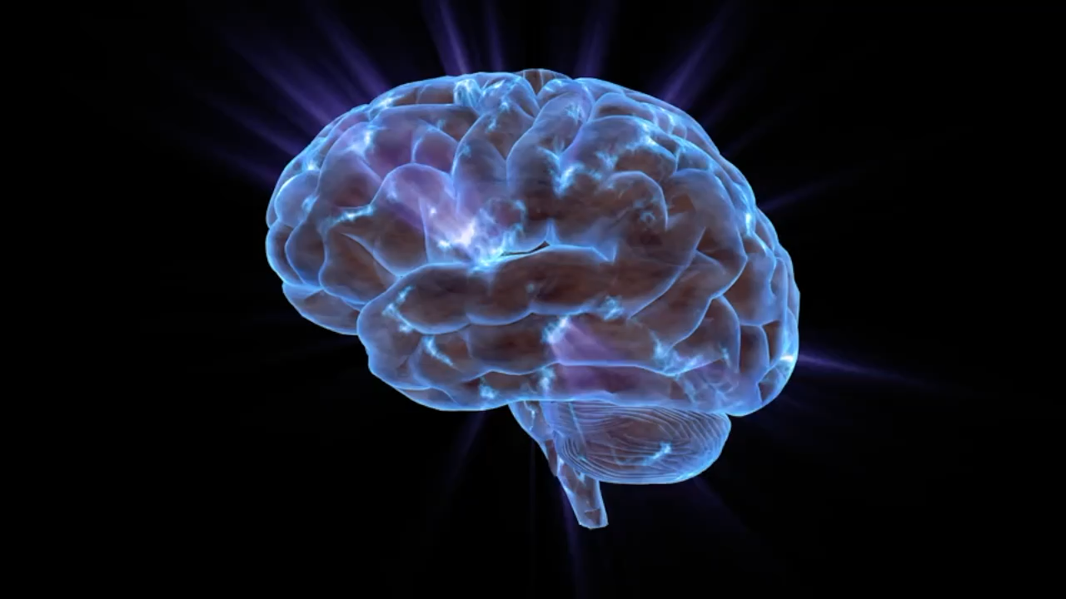
目 標
Notes:
https://pixabay.com/videos/brain-mind-knowledge-think-206173/

Slide 3
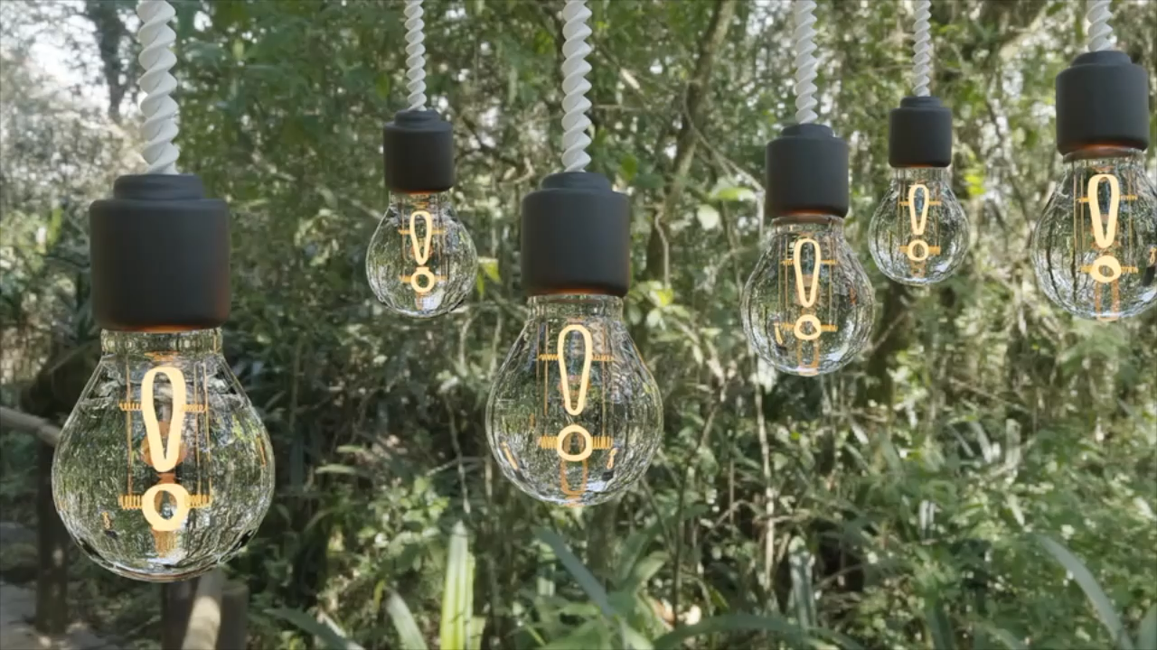
阻 礙
Notes:
https://pixabay.com/videos/light-bulbs-electricity-wind-idea-134061/

Slide 4

努 力
Notes:
https://pixabay.com/videos/ai-generated-friends-group-people-232496/

Slide 5
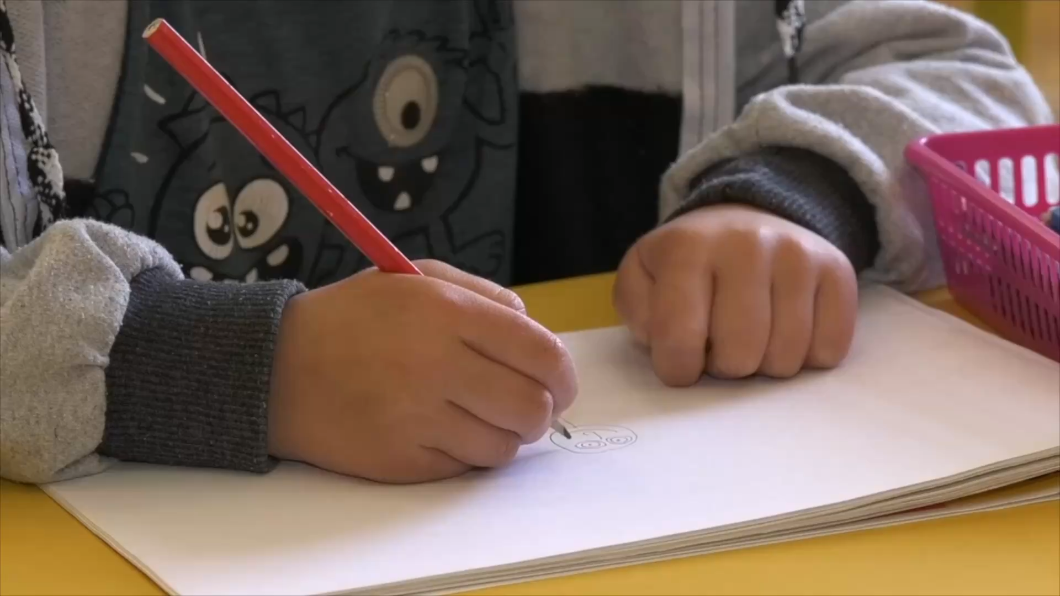
結 果
Notes:
https://pixabay.com/videos/child-drawing-kid-pencil-86242/

Slide 6

意 外
Notes:
https://pixabay.com/videos/glitch-monogram-data-code-retro-36784/

Slide 7
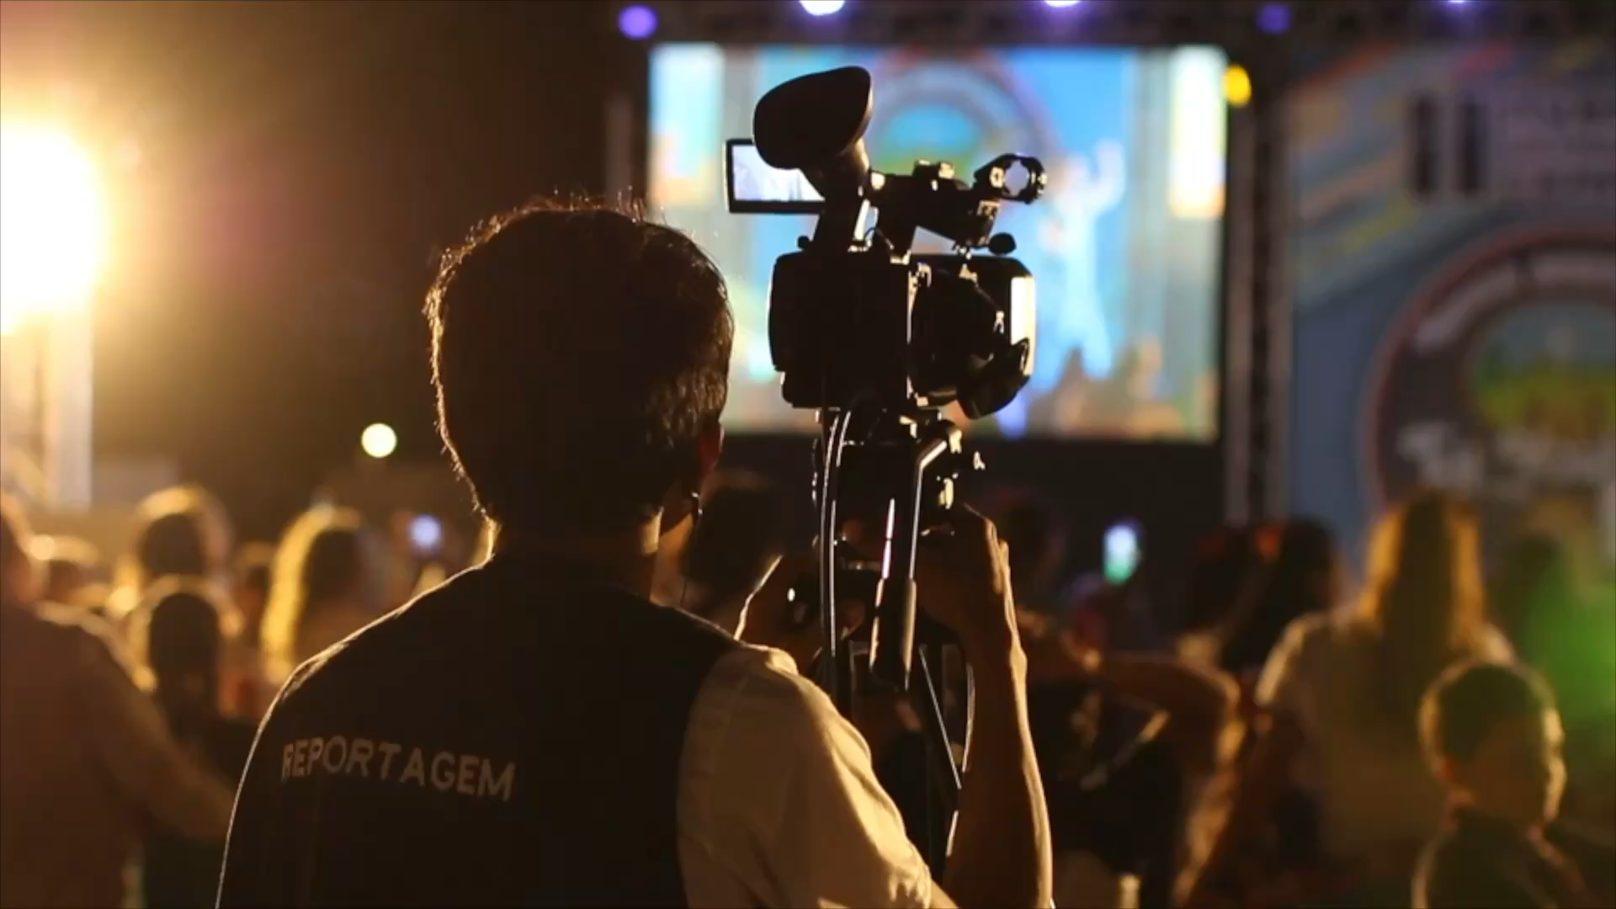
轉 折
Notes:
https://pixabay.com/videos/camera-camcorder-video-26531/

Slide 8
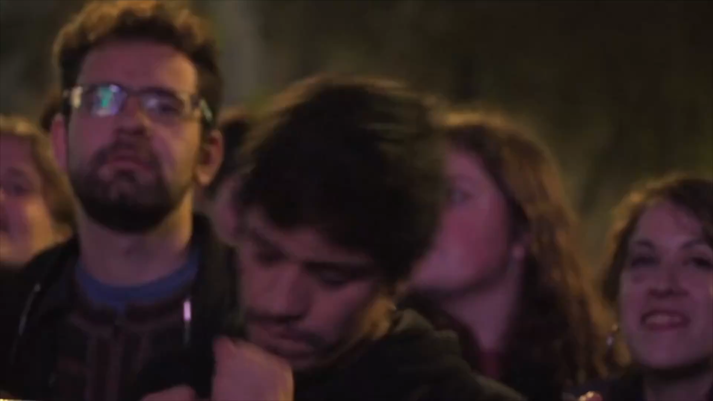
結 局
Notes:
https://pixabay.com/videos/people-dancing-party-dance-music-34411/

